Slide 1
Introduction to HTML

Slide 2
What is HTML?
Hyper Text Markup Language
  Web authoring software language
  Specifically created to make World Wide Web pages

Slide 3




How the Web Works?
WWW use classical client / server architecture
  HTTP is text-based request-response protocol
HTTP
HTTP
Server response
Server running Web Server Software (IIS, Apache, etc.)
Client running a Web Browser
Notes:
*
07/16/96
(c) 2007 National Academy for Software Development - http://academy.devbg.org. All rights reserved. Unauthorized copying or re-distribution is strictly prohibited.*
<number>##

Slide 4
What is HTML?
HTML files
  Text files
  Contain mark-up tags
  Tags direct how page is to be displayed by browser
  Can be created from a simple text editor
  File extension “.htm” or “.html”

Slide 5
What is a Web Page?
Web pages are text files containing HTML
HTML – Hyper Text Markup Language
  A notation for describing
    document structure (semantic markup)
    formatting (presentation markup)
  Looks (looked?) like:
    A Microsoft Word document
The markup tags provide information about the page content structure
Notes:
*
07/16/96
(c) 2007 National Academy for Software Development - http://academy.devbg.org. All rights reserved. Unauthorized copying or re-distribution is strictly prohibited.*
<number>##

Slide 6
Creating HTML Pages
An HTML file must have an .htm or .html file extension
HTML files can be created with text editors:
  NotePad, NotePad ++.
Or HTML editors
  Microsoft FrontPage
  Macromedia Dreamweaver
  Netscape Composer
  Microsoft Word
  Visual Studio
Notes:
*
07/16/96
(c) 2007 National Academy for Software Development - http://academy.devbg.org. All rights reserved. Unauthorized copying or re-distribution is strictly prohibited.*
<number>##

Slide 7


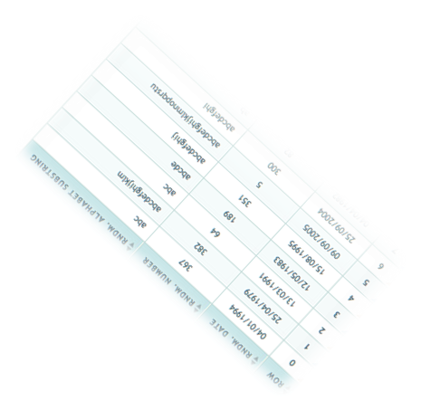


HTML Basics
Text, Images, Tables, Forms

Slide 8
Creating an HTML file
Notepad or Wordpad (PC)
First tag: <html>
  Indicates that you are starting an HTML document
Last tag: </html>
  Indicates that you are ending an HTML document
Save file as “index.html”
  This is a typical default title for home pages
  Windows may seem to prefer “.htm” but “.html” will also work just fine.

Slide 9
Index.html Example
<html>
</html>

Slide 10
Creating an HTML file (cont.)
Header information
  <head> to begin, and </head> to end
  Gives information about the page that is not displayed on the page itself
Page Title
  <title> to begin, and </title> to end
  Example: <title>TEIT Class</title>

Slide 11
answer:
<html>
<head>
<title>TEIT Class</title>
</head>
</html>

Slide 12
Creating Text in HTML
Body Tags
  <body> and </body>
  *Note* that all text that appears on the page must be encapsulated within the body tags
Text headings
  <h1> and </h1>
  There are six defined heading sizes
  <h1> (largest) through <h6> (smallest)
Paragraphs
  <p> and </p>

Slide 13
Text Example
<html>
<header>
<title>Transcriptions Studio</title>
</header>
<body>
<h1>This is a big heading!</h1>
<h2>This is a smaller heading</h2>
<p>This is an example of a paragraph.</p>
</body>
</html>

Slide 14
Text Example (cont.)
This is a big heading!
This is a smaller heading!
This is an example of a paragraph.

Slide 15
Comments Example
<html>
<header>
<title>Transcriptions Studio</title>
</header>
<body>
<h1>This is a big header!</h1>
<h2>This is a smaller heading</h2>
<p>This is an example of a paragraph.</p>
</body>
</html>
<!-- This is an example of a comment.-->

Slide 16
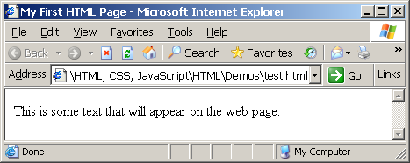
First HTML Page
test.html
<html>
<head>
<title>My First HTML Page</title>
</head>
<body>
<p>This is some text...</p>
</body>
</html>
Notes:
*
07/16/96
(c) 2007 National Academy for Software Development - http://academy.devbg.org. All rights reserved. Unauthorized copying or re-distribution is strictly prohibited.*
<number>##

Slide 17
First HTML Page: Tags
<html>
<head>
<title>My First HTML Page</title>
</head>
<body>
<p>This is some text...</p>
</body>
</html>
Opening tag
Closing tag
An HTML element consists of an opening tag, a closing tag and the content inside.
Notes:
*
07/16/96
(c) 2007 National Academy for Software Development - http://academy.devbg.org. All rights reserved. Unauthorized copying or re-distribution is strictly prohibited.*
<number>##

Slide 18
First HTML Page: Header
HTML header
<html>
<head>
<title>My First HTML Page</title>
</head>
<body>
<p>This is some text...</p>
</body>
</html>
Notes:
*
07/16/96
(c) 2007 National Academy for Software Development - http://academy.devbg.org. All rights reserved. Unauthorized copying or re-distribution is strictly prohibited.*
<number>##

Slide 19
First HTML Page: Body
<html>
<head>
<title>My First HTML Page</title>
</head>
<body>
<p>This is some text...</p>
</body>
</html>
HTML body
Notes:
*
07/16/96
(c) 2007 National Academy for Software Development - http://academy.devbg.org. All rights reserved. Unauthorized copying or re-distribution is strictly prohibited.*
<number>##

Slide 20
Tags Attributes
Tags can have attributes
  Attributes specify properties and behavior
  Example:
  Few attributes can apply to every element:
  <P ALIGN=CENTER>
Attribute align with value center

Slide 21
Definitions
W W W – World Wide Web.
HTML – HyperText Markup Language – The Language of Web Pages on the World Wide Web.
HTML is a text formatting language.
URL – Uniform Resource Locator.
Browser – A software program which is used to show web pages.

Slide 22
Background
Bgcolor
Specifies a background-color for a HTML page.
<body bgcolor="#000000"> <body bgcolor="rgb(0,0,0)"> <body bgcolor="black">
Background
Specifies a background-image for a HTML page
<body background="clouds.gif">
<body background="http://www.w3schools.com/clouds.gif">

Slide 23
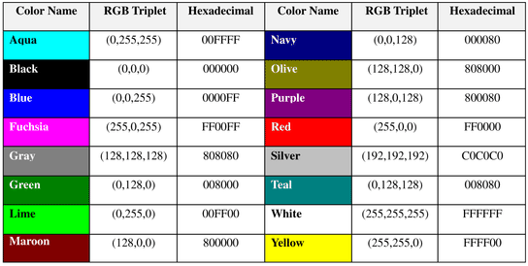
16 Basic Colors

Slide 24
Color Codes
WHITE
BLACK
RED
GREEN
BLUE
MAGENTA
CYAN
YELLOW
AQUAMARINE
BAKER’S CHOCOLATE
VIOLET
BRASS
COPPER
PINK
ORANGE
#FFFFFF
#000000
#FF0000
#00FF00
#0000FF
#FF00FF
#00FFFF
#FFFF00
#70DB93
#5C3317
#9F5F9F
#B5A642
#B87333
#FF6EC7
#FF7F00

Slide 25
Text
Put text on a webpage
  <p>Today is my first day at my new job, I’m so excited!</p>
  Output: Today is my first day at my new job, I’m so excited!
Put text in center of a page
  <center>Hello</center>
  Output: Hello
Put text on the right of a page
  <p align=“right”>Hello</p>
  Output: Hello

Slide 26
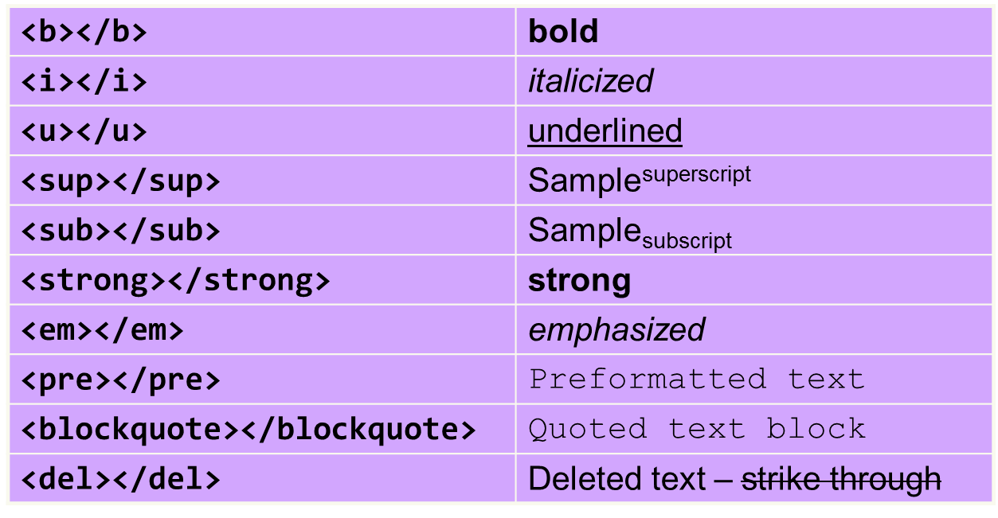
Text Formatting
Text formatting tags modify the text between the opening tag and the closing tag
  Ex. <b>Hello</b> makes “Hello” bold
Notes:
*
07/16/96
(c) 2007 National Academy for Software Development - http://academy.devbg.org. All rights reserved. Unauthorized copying or re-distribution is strictly prohibited.*
<number>##

Slide 27
Font
To change text size
  <font size=“3”>Hello</font>
  Output: Hello
To change text color
  <font color=“red”>Hello</font>
  Output: Hello
Using both
  <font size=“3” color=“red”>Hello</font>
  Output: Hello
Tag attribute
Notes:
Tags can have attributes. Attributes can provide additional information about the HTML elements on your page.
Attributes always come in name/value pairs like this: name="value".
Attributes are always added to the start tag of an HTML element

Slide 28
Headings
There are 6 heading commands.
<H1>This is Heading 1</H1>
<H2>This is Heading 2</H2>
<H3>This is Heading 3</H3>
<H4>This is Heading 4</H4>
<H5>This is Heading 5</H5>
<H6>This is Heading 6</H6>
Notes:
A number of tags are defined to be used to indicate section headings within a document. Typically a document contains a number of sections (chapters), and within each section are subsections, and within subsections are sub-subsections, and so on. The heading tags are <h1>, <h2>, <h3>, ... <h6>, with H1 being the highest level heading (usually rendered the largest) and H6 the lowest level heading.

Slide 29
Paragraphs, <P> </P>
Paragraphs allow you to add text to a document in such a way that it will automatically adjust the end of line to suite the window size of the browser in which it is being displayed. Each line of text will stretch the entire length of the window.

Slide 30
Paragraphs, <P> </P>
<HTML><HEAD>
<TITLE> Example Page</TITLE>
</HEAD>
<BODY></H1> Heading 1 </H1>
<P> Paragraph 1, ….</P>
<H2> Heading 2 </H2>
<P> Paragraph 2, ….</P>
<H3> Heading 3 </H3>
<P> Paragraph 3, ….</P>
<H4> Heading 4 </H4>
<P> Paragraph 4, ….</P>
<H5> Heading 5 </H5>
<P> Paragraph 5, ….</P>
<H6> Heading 6</H6>
<P> Paragraph 6, ….</P>
</BODY></HTML>
Heading 1
Paragraph 1,….
Heading 2
Paragraph 2,….
Heading 3
Paragraph 3,….
Heading 4
Paragraph 4,….
Heading 5
Paragraph 5,….
Heading 6
Paragraph 6,….

Slide 31
Break, <BR>
Line breaks allow you to decide where the text will break on a line or continue to the end of the window.
A <BR> is an empty Element, meaning that it may contain attributes but it does not contain content.
The <BR> element does not have a closing tag.

Slide 32
Break, <BR>
<HTML>
<HEAD>
<TITLE> Example Page</TITLE>
</HEAD>
<BODY>
<H1> Heading 1 </H1>
<P>Paragraph 1, <BR>
Line 2 <BR> Line 3 <BR>….
</P>
</BODY>
</HTML>
Heading 1
Paragraph 1,….
Line 2
Line 3
….

Slide 33
Horizontal Rule, <HR>
The <HR> element causes the browser to display a horizontal line (rule) in your document.
<HR> does not use a closing tag, </HR>.

Slide 34
Horizontal Rule, <HR>
Attribute | Description | Default Value
SIZE | Height of the rule in pixels | 2 pixels
WIDTH | Width of the rule in pixels or percentage of screen width | 100%
NOSHADE | Draw the rule with a flat look instead of a 3D look | Not set (3D look)
ALIGN | Aligns the line (Left, Center, Right) | Center
COLOR | Sets a color for the rule (IE 3.0 or later) | Not set

Slide 35
Bold, Italic and other Character Formatting Elements
<EM> Emphasis </EM> Browsers usually display this as italics.
<STRONG> STRONG </STRONG> Browsers display this as bold.
<TT> TELETYPE </TT> Text is displayed in a mono-spaced font. A typewriter text, e.g. fixed-width font.
<CITE> Citation </CITE> represents a document citation (italics). For titles of books, films, etc. Typically displayed in italics. (A Beginner's Guide to HTML)

Slide 36
Alignment
Some elements have attributes for alignment (ALIGN) e.g. Headings, Paragraphs and Horizontal Rules.
The Three alignment values are : LEFT, RIGHT, CENTER.
<CENTER></CENTER> Will center elements.

Slide 37
Alignment
<DIV ALIGN=“value”></DIV> Represents a division in the document and can contain most other element type. The alignment attribute of the DIV element is well supported.
<TABLE></TABLE> Inside a TABLE, alignment can be set for each individual cell.

Slide 38
List
Unordered list
  Code:
  <ul>
  <li>Coffee</li> <li>Milk</li>
  </ul>
  Output:
    Coffee
    Milk
Ordered list
  Code:
  <ol>
  <li>Coffee</li> <li>Milk</li>
  </ol>
  Output:
    Coffee
    Milk
Notes:
HTML supports ordered (numbered) and unordered lists. Each list can include a number of list items, the browser renders these list items in a way that (hopefully) appears as a list.
Unordered lists are contained within the tags <ul> and </ul>. Ordered lists are contained within the <ol> and </ol> tags. In both cases each individual list item is contained within the <li> and </li> tags.

Slide 39
List Elements
TYPE | Numbering | Styles
1 | Arabic numbers | 1,2,3, ……
a | Lower alpha | a, b, c, ……
A | Upper alpha | A, B, C, ……
i | Lower roman | i, ii, iii, ……
I | Upper roman | I, II, III, ……

Slide 40
List Elements
You can specify a starting number for an ordered list.
<OL TYPE =“i”>
<LI> List item …</LI>
<LI> List item …</LI>
</OL>
<P> text ….</P>
<OL TYPE=“i” START=“3”>
<LI> List item …</LI>
</OL>

Slide 41
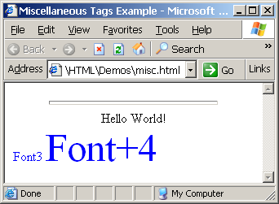
Miscellaneous Tags – Example
misc.html
<html>
<head>
<title>Miscellaneous Tags Example</title>
</head>
<body>
<hr size="5" width="70%" />
<center>Hello World!</center>
<font size="3" color="blue">Font3</font>
<font size="+4" color="blue">Font+4</font>
</body>
</html>

Slide 42
Ordered Lists: <ol> Tag
Create an Ordered List using <ol></ol>:
Attribute values for type are 1, A, a, I, or i
<ol type="1">
<li>Apple</li>
<li>Orange</li>
<li>Grapefruit</li>
</ol>
Apple
Orange
Grapefruit
Apple
Orange
Grapefruit
Apple
Orange
Grapefruit
Apple
Orange
Grapefruit
Apple
Orange
Grapefruit
Notes:
*
07/16/96
(c) 2007 National Academy for Software Development - http://academy.devbg.org. All rights reserved. Unauthorized copying or re-distribution is strictly prohibited.*
<number>##

Slide 43
Unordered Lists: <ul> Tag
Create an Unordered List using <ul></ul>:
Attribute values for type are:
  disc, circle or square
<ul type="disk">
<li>Apple</li>
<li>Orange</li>
<li>Grapefruit</li>
</ul>
Apple
Orange
Pear
Apple
Orange
Pear
Apple
Orange
Pear
Notes:
*
07/16/96
(c) 2007 National Academy for Software Development - http://academy.devbg.org. All rights reserved. Unauthorized copying or re-distribution is strictly prohibited.*
<number>##

Slide 44
Definition lists: <dl> tag
Create definition lists using <dl>
  Pairs of text and associated definition; text is in <dt> tag, definition in <dd> tag
  Renders without bullets
  Definition is indented
<dl>
  <dt>HTML</dt>
  <dd>A markup language …</dd>
  <dt>CSS</dt>
  <dd>Language used to …</dd>
</dl>

